Slide 1
Selection

Slide 2
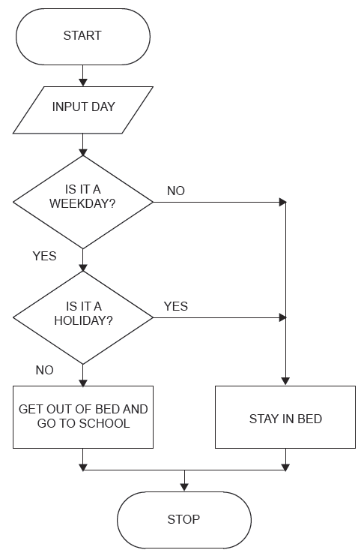
Selection
All the programs you have been developing so far have been sequential, this means that each instruction is executed in a set order.
With selection the path through a program can be decided by looking at a condition and then taking one of a set of alternative paths based on the result.
Selection in flowcharts is represented using the decision symbol.

Slide 3
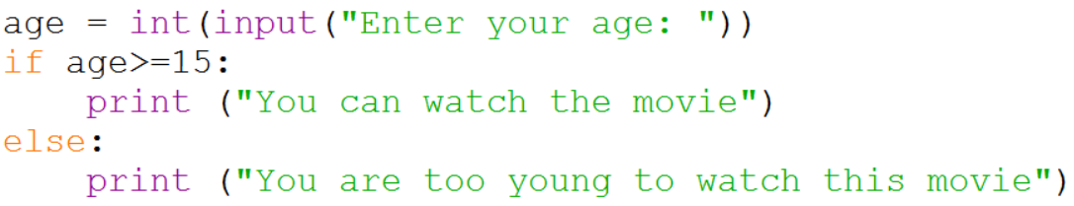
Example 1
Start
Input Age
Is Age>=15?
Yes
No
Display “You can watch this movie”
Display “You are too young to watch this movie”
Match the code to the flowchart and then create the program in Python.
End

Slide 4
Comparison Operators
== | Is equal to
> | Is greater than
< | Is less than
!= | Is not equal to
>= | Is greater than or equal to
<= | Is less than or equal to
You can also use the logical operators AND, OR and NOT.

Slide 5
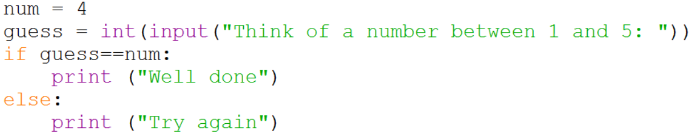
Example 2
Start
Yes
No
Complete the flowchart and then create the program in Python.
End

